Slide 1
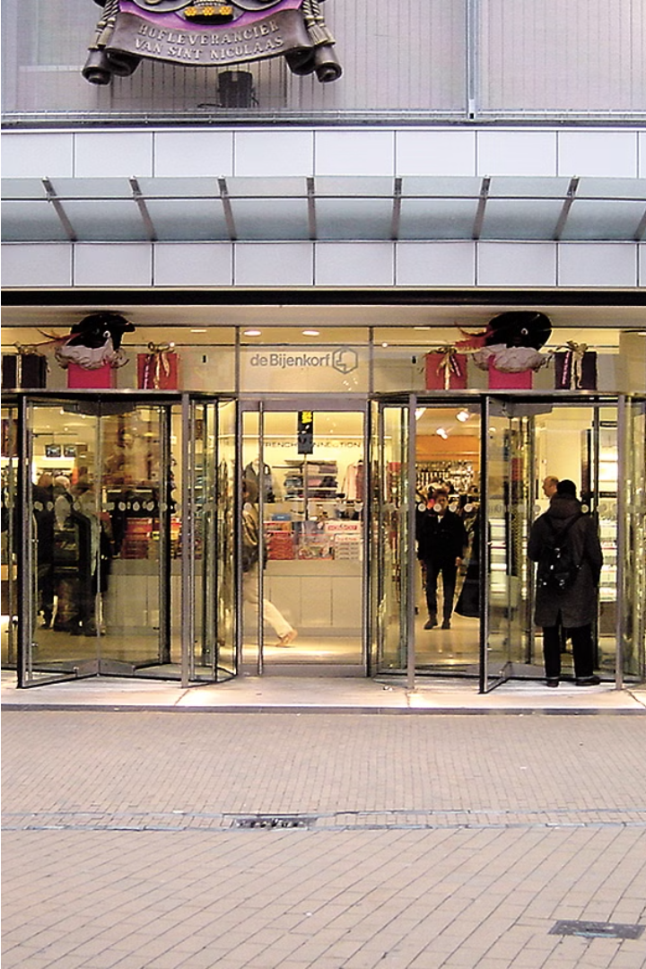
Good morning everyone. My name is Lina Al-Dosari. I am a student at Prince Sattam bin Abdulaziz University and I study programming and computer science. Today I am excited to share my presentation on “Shopping.” Thank you for your interest.

Slide 2
Introduction to Shopping
Shopping is a fundamental part of modern life, allowing us to obtain the goods and services we need. From daily errands to special occasions, the act of shopping encompasses a wide range of experiences and considerations.

Slide 3
Types of Shoppers
Bargain Hunters
Impulsive Shoppers
Methodical Shoppers
These shoppers prioritize finding the best deals and discounts, often scouring for sales and coupons.
Driven by emotion and desire, impulsive shoppers make unplanned purchases based on immediate gratification.
Planners who research options thoroughly, methodical shoppers aim to make informed and rational decisions.

Slide 4

In-Store Shopping vs. Online Shopping
In-Store
Enables immediate gratification, hands-on product experience, and personal interaction with sales associates.
Hybrid
Many shoppers now combine the two, using online research to inform in-store purchases.
1
2
3
Online
Offers convenience, a wider selection, and the ability to easily compare prices and reviews.

Slide 5
Budgeting and Saving Money
Create a Budget
Look for Deals
Establish a spending plan and stick to it to avoid overspending.
Research sales, coupons, and discounts to maximize your savings.
Delayed Gratification
Use Credit Wisely
Resist the urge to make impulse purchases and give yourself time to consider if you really need an item.
Avoid excessive debt by paying off balances in full and on time.

Slide 6




Shopping Trends and Innovations
Mobile Shopping
Sustainable Shopping
Personalization
Omnichannel Retail
The rise of smartphone-enabled shopping experiences and mobile apps.
Consumers' growing demand for eco-friendly and ethical products.
Customized recommendations and tailored shopping experiences.
The integration of in-store, online, and mobile shopping channels.

Slide 7
References
For more information on the topics covered, please refer to the following sources:
Types of Shoppers
In-Store vs. Online Shopping
Factors Influencing Shopping Decisions
Budgeting and Saving Money

